Slide 1

Department of Mathematics and Statistics, Sejong University
Bootstrapping for Fuzzy Mediation and Analysis
using FLSE and FLAD with Evolutionary Algorithms
Da Jeong Kang, Hyeon Gu Kang, Jin Hee Yoon
1/26

Slide 2
Contents
I. Introduction
IV. Results
1. Mediation Analysis
1. Analysis Results
2. Comparing Algorithms and Improving the Accuracy of Causal Analysis
3. Changes in FRMSE and FMAE with Bootstrap as Epochs Increase
II. Preliminaries
1. Fuzzy theory
2. Evolutionary Algorithm
3. Model Performance Measurement Metrics
V. Conclusions
III. Main Contribution
1. Simple Fuzzy Mediation Model
2. Bootstrapping
3. FLSE & FLAD
4. Interval Estimation Using Sobel method
5. Proposed Bootstrap Confidence Interval
6. Data Analysis
2/26

Slide 3
Contents
I. Introduction
1. Mediation Analysis
3/26

Slide 4
01
Bootstrapping for Fuzzy Mediation and Analysis using FLSE and FLAD with Evolutionary Algorithms
Introduction
(1) Mediation Analysis
Analyzing how the independent variable (X) influences the dependent variable (Y) through the mediator (M).
Analyzing complex causal relationships and validating the significance of mediation effects.
Sobel Test
Baron and Kenny Test
Assumes sample distribution follows a normal distribution
Potential for bias
.
Difficulty detecting significance with small effect sizes or sample sizes
Criticized for lack of statistical rigor
Bootstrapping
Bootstrapping offers the advantage of not requiring a normal distribution assumption and provides more reliable confidence intervals, even with small sample sizes.
4/26

Slide 5
01
Bootstrapping for Fuzzy Mediation and Analysis using FLSE and FLAD with Evolutionary Algorithms
Introduction
(2) Fuzzy Mediation Analysis
Fuzzy Data-Based Mediation -Analysis
Under the assumption that the sample distribution is normal, confidence intervals are calculated.
Bootstrap Methods with Fuzzy Data
Bootstrap techniques are applied to fuzzy data to estimate the precision of statistical estimates. This involves repeatedly resampling the fuzzy data and recalculating estimates to assess variability and construct confidence intervals. It's a powerful method for dealing with limited or uncertain data sets.
5/26

Slide 6
Contents
II. Preliminaries
1. Fuzzy Theory
2. Evolutionary Algorithm
3. Model Performance Measurement Metrics
6/26

Slide 7
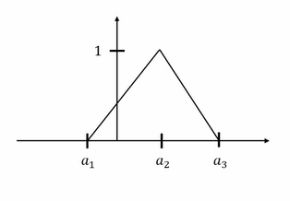



02
Bootstrapping for Fuzzy Mediation and Analysis using FLSE and FLAD with Evolutionary Algorithms
Preliminaries
Fuzzy theory is based on 'degree' and deals with uncertainty, effectively handling ambiguous information
Fuzzy Theory
Triangular Fuzzy Number
A = $(a_{1},a_{2}$, $a_{3}$)
$μ_{A}\left(x\right)=\left\{\begin{aligned}\frac{x−a_{1}}{a_{2}−a_{1}} a_{1}≤ x<a_{2}, \\ \frac{x−a_{1}}{a_{2}−a_{1}}{ a}_{2}≤ x<a_{3}, \\ 0 otherwise\end{aligned}\right.$
$X ⊕ Y$ = ($l_{x}+ l_{y}, x+y, r_{x}+ r_{y})$
$kX= \left\{\begin{aligned}\left(l_{x},kx,kr_{x}\right) if k≥0 \\ \left(kr_{x},kx,kl_{x}\right) if k<0\end{aligned}\right.$
7/26

Slide 8
01
Bootstrapping for Fuzzy Mediation and Analysis using FLSE and FLAD with Evolutionary Algorithms
Preliminaries
(2) Evolutionary Algorithm
A computational method that mimics natural evolution to optimize solutions iteratively.
Genetic Algorithm (GA)
Harmony Search Algorithm (HS)
Optimization strategy based on principles of evolution
Develops solutions through selection, crossover, and mutation
Applied across various industries for complex optimization problems
.
Optimization process inspired by musical improvisation
Continuous solution improvement using Harmony Memory
Efficient blend of global and local search techniques
GA and HS for Fuzzy Data
Metaheuristic approach for resolving complex and uncertain fuzzy data
Excellent in optimizing search spaces and managing uncertainty
11/26

Slide 9


01
Bootstrapping for Fuzzy Mediation and Analysis using FLSE and FLAD with Evolutionary Algorithms
Preliminaries
(3) Model Performance Measurement Metrics
Model performance measurement metrics are quantitative indicators used to assess the accuracy and efficacy of a statistical model in making predictions or decisions.
FRMSE
FMAE
FRMSE extends the traditional RMSE by incorporating fuzzy set theory, allowing for a more nuanced assessment of model predictions by accounting for uncertainty in the data.
$$FRMSE = \sqrt{\frac{1}{n}\sum_{i=1}^{n}{D_{2}{({\tilde{Y}}_{i }− \hat{Y_{i}})}^{2}}}$$
FMAE integrates fuzzy set theory into traditional MAE, weighting errors based on the degree of uncertainty and providing a more robust measure for datasets with outliers or imprecise values.
$$FMAE = \frac{1}{n}\sum_{i=1}^{n}{(|l_{{\tilde{y}}_{i}}−l_{{\hat{y}}_{i}}|+|{\tilde{y}}_{i}−{\hat{y}}_{i}|+|r_{{\tilde{y}}_{i}}−r_{{\hat{y}}_{i}}|) }$$
These two fuzzy-based metrics are more resilient to outliers and better handle data uncertainty compared to traditional error metrics.
12/26

Slide 10
Contents
III. Main Contribution
1. Simple Fuzzy Mediation Model
2. Bootstrapping
3. FLSE & FLAD
4. Interval Estimation Using Sobel method
5. Proposed Bootstrap Confidence Interval
6. Data Analysis
14/26

Slide 11
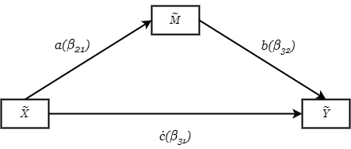
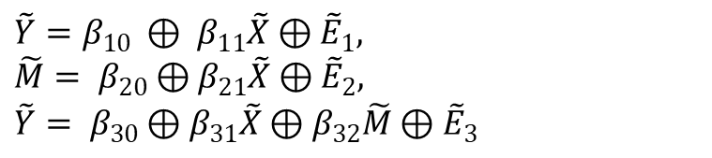
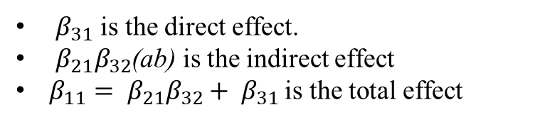
01
Bootstrapping for Fuzzy Mediation and Analysis using FLSE and FLAD with Evolutionary Algorithms
Preliminaries
(1) Simple Fuzzy Mediation Model
$\tilde{Y}=β_{10} ⊕ β_{11}\tilde{X}⊕{\tilde{E}}_{1},$
$\tilde{M}= β_{20}⊕β_{21}\tilde{X}⊕{\tilde{E}}_{2},$
$\tilde{Y}= β_{30}⊕β_{31}\tilde{X}⊕β_{32}\tilde{M}⊕{\tilde{E}}_{3}$
$β_{31}$ is the direct effect.
$β_{21}β_{32}$(ab) is the indirect effect
$β_{11}= β_{21}β_{32}+ β_{31}$ is the total effect
8/26

Slide 12
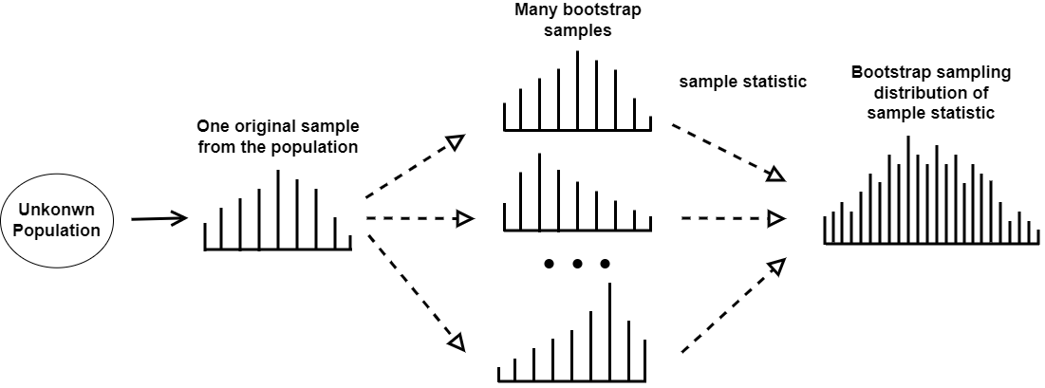
03
Bootstrapping for Fuzzy Mediation and Analysis using FLSE and FLAD with Evolutionary Algorithms
Main Contribution
(2) Bootstrapping
A statistical resampling technique that calculates estimates and confidence intervals for statistics from sample data through random sampling with replacement
15/26

Slide 13

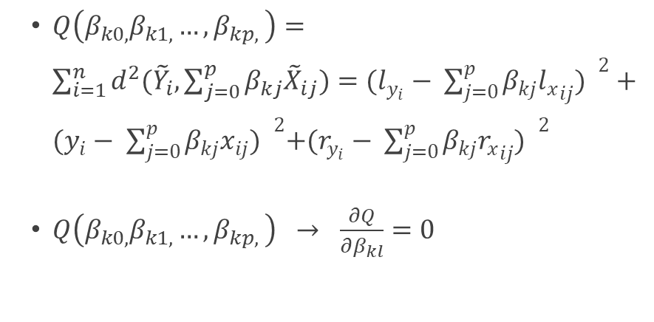
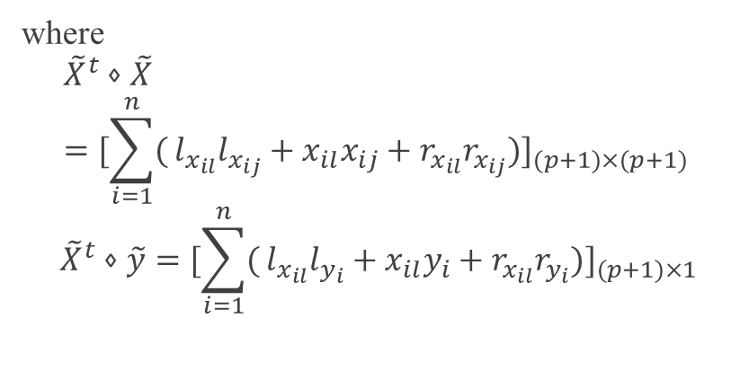
02
Bootstrapping for Fuzzy Mediation and Analysis using FLSE and FLAD with Evolutionary Algorithms
Preliminaries
(3) FLSE & FLAD
Fuzzy Least Squares Estimation (FLSE)
$$\tilde{Y_{i}}=β_{0}⨁β_{1}{\tilde{X}}_{1i}⨁β_{2}{\tilde{X}}_{2i}⨁⋯⨁β_{p}{\tilde{X}}_{pi}⨁\tilde{E_{i}}$$
$$\hat{β_{k}}={\left({\tilde{X}}^{t}⋄\tilde{X}\right)}^{−1}{\tilde{X}}^{t}⋄\tilde{y}$$
$Q\left(β_{k0,}β_{k1,}{…,β}_{kp,}\right)=\sum_{i=1}^{n}{d^{2}({\tilde{Y}}_{i}, \sum_{j=0}^{p}{β_{kj}{\tilde{X}}_{ij})=(l_{y_{i}}− {\sum_{j=0}^{p}{β_{kj}{l_{x}}_{ij}) }}^{2}+ {(y_{i}− \sum_{j=0}^{p}{β_{kj}x_{ij}) }}^{2}+{(r_{y_{i}}− \sum_{j=0}^{p}{β_{kj}{r_{x}}_{ij}) }}^{2}}}$
$Q\left(β_{k0,}β_{k1,}{…,β}_{kp,}\right) → \frac{∂Q}{∂β_{kl}}=0$
where
$${\tilde{X}}^{t}⋄\tilde{X}={[\sum_{i=1}^{n}{(}l_{x_{il}}l_{x_{ij}}+x_{il}x_{ij}+r_{x_{il}}r_{x_{ij}})]}_{(p+1)×(p+1) }$$
$${\tilde{X}}^{t}⋄\tilde{y}={[\sum_{i=1}^{n}{(}l_{x_{il}}l_{y_{i}}+x_{il}y_{i}+r_{x_{il}}r_{y_{i}})]}_{(p+1)×1}$$
$d^{2}\left(X,Y \right)=D_{2}^{2}\left(Supp X,Supp Y\right)+[{m_{l}\left(X\right)−m_{l}\left(Y\right)]}^{2}$ $+[{m_{r}\left(X\right)−m_{r}\left(Y\right)]}^{2}$
$d^{2}\left(X,Y \right)=D_{2}^{2}\left(Supp X,Supp Y\right)+[{m_{l}\left(X\right)−m_{l}\left(Y\right)]}^{2}$ $+[{m_{r}\left(X\right)−m_{r}\left(Y\right)]}^{2}$
9/26

Slide 14
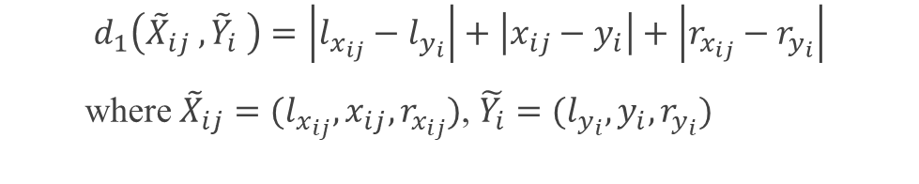

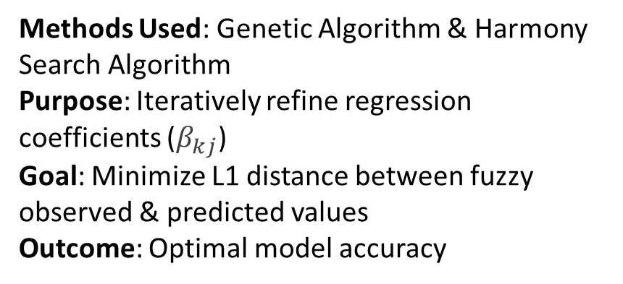
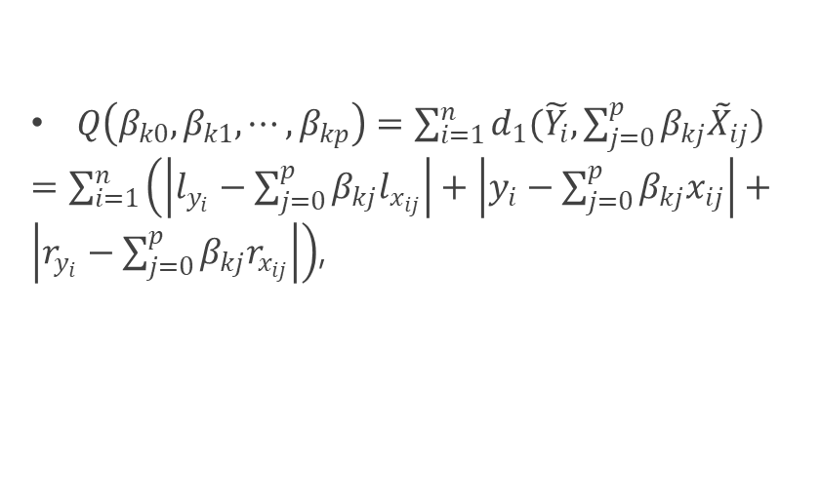
02
Bootstrapping for Fuzzy Mediation and Analysis using FLSE and FLAD with Evolutionary Algorithms
Preliminaries
(3) FLSE & FLAD
Fuzzy Least Absolute Deviation (FLAD)
$\tilde{Y_{i}}=β_{0}⨁β_{1}{\tilde{X}}_{1i}⨁β_{2}{\tilde{X}}_{2i}⨁⋯⨁β_{p}{\tilde{X}}_{pi}⨁\tilde{E_{i}}$.
$$\text{Minimizing} \text{Objective} \text{Function} \text{in} \text{FuzzyRegression} \text{Model}$$
$Q\left(β_{k0},β_{k1}, ⋯, β_{kp}\right)=\sum_{i=1}^{n}{d_{1}(\tilde{Y_{i}},\sum_{j=0}^{p}{β_{kj}{\tilde{X}}_{ij})}}$
$=\sum_{i=1}^{n}{\left(\left|l_{y_{i}}−\sum_{j=0}^{p}{β_{kj}l_{x_{ij}}}\right|+\left|y_{i}−\sum_{j=0}^{p}{β_{kj}x_{ij}}\right|+\left|r_{y_{i}}−\sum_{j=0}^{p}{β_{kj}r_{x_{ij}}}\right|\right)}$,
Methods Used: Genetic Algorithm & Harmony Search Algorithm
Purpose: Iteratively refine regression coefficients ($β_{kj}$)
Goal: Minimize L1 distance between fuzzy observed & predicted values
Outcome: Optimal model accuracy
$$d_{1}\left({\tilde{X}}_{ij} ,{\tilde{Y}}_{i} \right)=\left|l_{x_{ij}}−l_{y_{i}}\right|+\left|x_{ij}−y_{i}\right|+\left|r_{x_{ij}}−r_{y_{i}}\right|$$
where ${\tilde{X}}_{ij}=(l_{x_{ij}}, x_{ij}, r_{x_{ij}})$, $\tilde{Y_{i}}=(l_{y_{i}}, y_{i}, r_{y_{i}})$
10/26

Slide 15
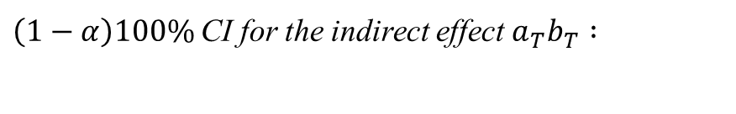

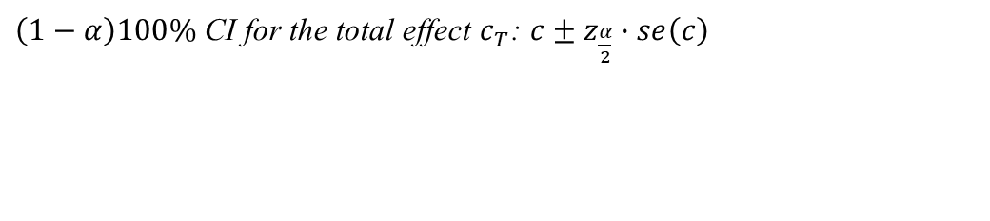

01
Bootstrapping for Fuzzy Mediation and Analysis using FLSE and FLAD with Evolutionary Algorithms
Preliminaries
(4) Interval Estimation Using Sobel method
Statistical Inference for Total and Direct Effects
Statistical Inference for Indirect Effects
$\left(1−α\right)100\%$CI for the indirect effect $a_{T}b_{T} :$
$\left(1−α\right)100\%$CI for the total effect $c_{T}$: $c±z_{\frac{α}{2}}∙se\left(c\right)$
$$ab±z_{\frac{α}{2}}∙se\left(ab\right)$$
$\left(1−α\right)100\%$CI for the direct effect ${c^{′}}_{T}:$ $c^{′}±z_{\frac{α}{2}}∙se\left(c^{′}\right)$
where $se\left(ab\right)=\sqrt{a^{2}se_{b}^{2}+b^{2}se_{a}^{2}+se_{a}^{2}se_{b}^{2}}$
$$se\left(c\right)=se\left(c′\right)=\frac{FSD}{\sqrt{n}}$$
$$FSD=\sqrt{\frac{1}{n−1}\sum_{h=1}^{n}{d^{2}\left({\tilde{X}}_{h},\overline{\tilde{X}}\right).}}$$
13/26

Slide 16


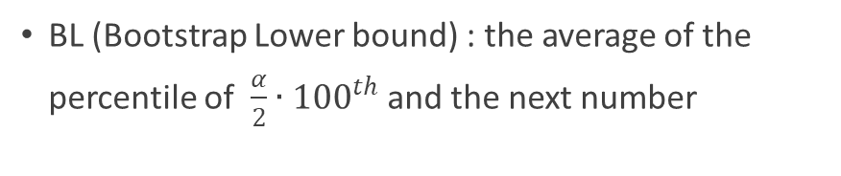

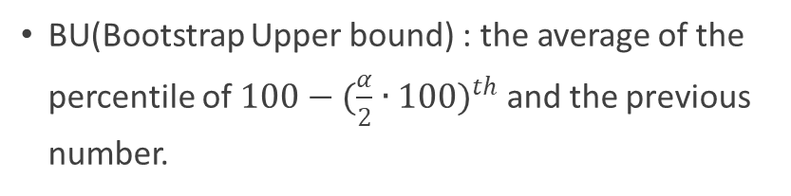

03
Bootstrapping for Fuzzy Mediation and Analysis using FLSE and FLAD with Evolutionary Algorithms
Main Contribution
(5) Proposed Bootstrap Confidence Interval
Bootstrap samples : ${\tilde{X}}_{1}^{∗}$, ${\tilde{X}}_{2}^{∗}$, ${\tilde{X}}_{3}^{∗}$, $⋯ ,{\tilde{X}}_{B}^{∗}$
↓
$α$ = 0.05
Estimated statistics : {$\hat{β_{1}^{∗}}$, $\hat{β_{2}^{∗}}$, $⋯, \hat{β_{B}^{∗}}$}
BL (Bootstrap Lower bound) : the average of the percentile of ${\frac{α}{2}∙100}^{th}$ and the next number
↓
$\hat{β_{(1)}^{∗}}$ ≤ $\hat{β_{(2)}^{∗}}$ ≤ · · · ≤ $\hat{β_{(B)}^{∗}}$
BU(Bootstrap Upper bound) : the average of the percentile of $100−({\frac{α}{2}∙100)}^{th}$ and the previous number.
16/26

Slide 17
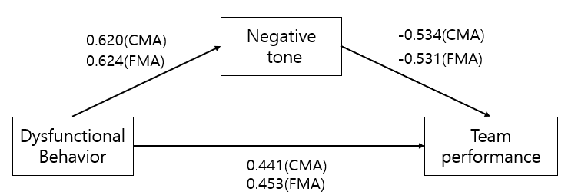

03
Bootstrapping for Fuzzy Mediation and Analysis using FLSE and FLAD with Evolutionary Algorithms
Main Contribution
(6) Data Analysis
Hypothesis: Dysfunctional team behavior is positively associated with a team's negative emotional tone.
Mediator: Negative emotional tone as a potential mediator.
Reasoning: Such behaviors can damage team reputation and threaten goal achievement.
Sample Size: n = 60
Data Processing: All variables fuzzified with a spread of 0.05
17/26

Slide 18
03
Bootstrapping for Fuzzy Mediation and Analysis using FLSE and FLAD with Evolutionary Algorithms
Main Contribution
(6) Data Analysis
Dysfunctional Behavior (X): Measures the frequency of team members engaging in negative acts that hinder work or inhibit innovation.
Team Performance (Y): Supervisor's assessment of how efficiently a team completes tasks and achieves goals. High performance reflects the quality of work, teamwork, and timeliness.
Negative Tone (M): Frequency at which team members experience feelings like anger or disgust in the workplace.
18/26

Slide 19
Contents
IV. Results
1. Analysis Results
2. Comparing Algorithms and Improving the Accuracy of Causal Analysis
3. Changes in FRMSE and FMAE with Bootstrap as Epochs Increase
19/26

Slide 20
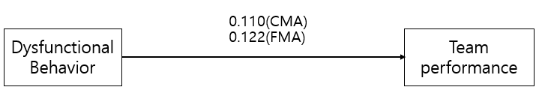
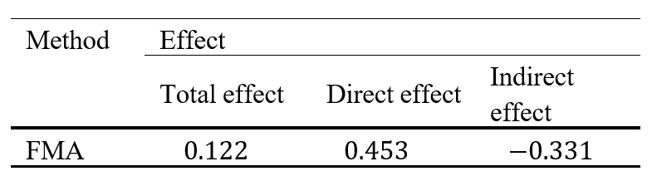
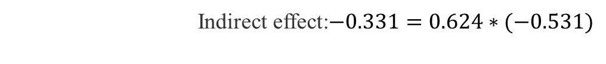

04
Bootstrapping for Fuzzy Mediation and Analysis using FLSE and FLAD with Evolutionary Algorithms
Results
(1) Analysis Results
$$\hat{\tilde{M}}= 0.025⊕0.624\tilde{X}$$
$$\hat{\tilde{Y}}= −0.022⊕0.453\tilde{X}⊕(−0.531)\tilde{M}$$
Total effect: $0.122=0.453+ (−0.331)$
Indirect effect:$−0.331=0.624∗(−0.531)$
20/26

Slide 21
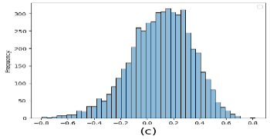
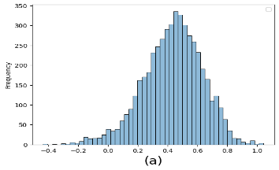
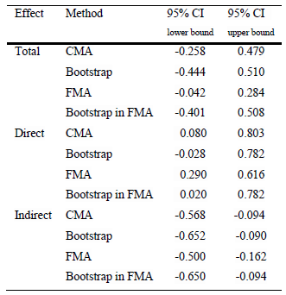
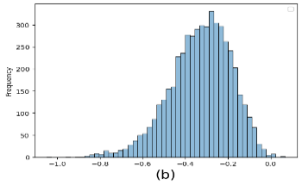

04
Bootstrapping for Fuzzy Mediation and Analysis using FLSE and FLAD with Evolutionary Algorithms
Results
(1) Analysis Results
Total effect
Direct effect
Indirect effect
21/26

Slide 22
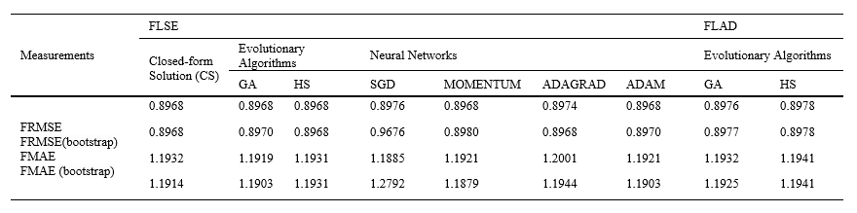
04
Bootstrapping for Fuzzy Mediation and Analysis using FLSE and FLAD with Evolutionary Algorithms
Results
(2) Comparing Algorithms and Improving the Accuracy of Causal Analysis
To enhance the stability of parameter estimates in the face of limited data, we advocate the use of the bootstrap method. This technique bolsters the robustness and reliability of our causal analysis
22/26

Slide 23
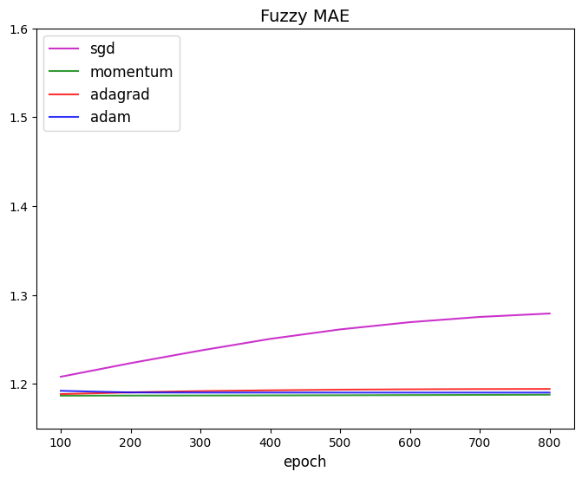
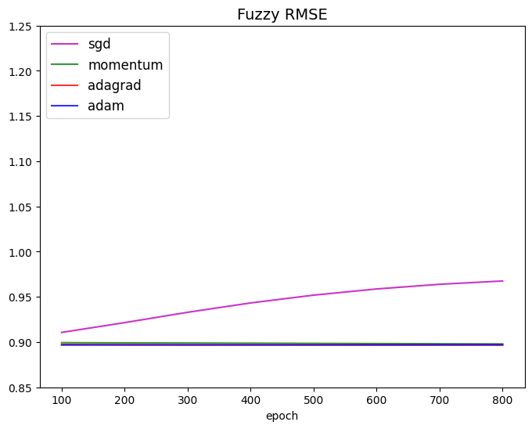
04
Bootstrapping for Fuzzy Mediation and Analysis using FLSE and FLAD with Evolutionary Algorithms
Results
(3) Changes in FRMSE and FMAE with Bootstrap as Epochs Increase
As epochs increase, there is a tendency for the metrics to decrease
Minor discrepancies occur due to the complexity of the parameter model used
The bootstrap method is capable of mitigating the instability in parameter estimation due to limited data
23/26

Slide 24
Contents
V. Conclusions
24/26

Slide 25
05
Bootstrapping for Fuzzy Mediation and Analysis using FLSE and FLAD with Evolutionary Algorithms
Conclusions
Bootstrapping
Fuzzy Data
Increases stability of parameter estimates with limited data
Enhances robustness and reliability in causal analysis
Reduces estimation instability in small datasets
Reduced Possibility of Information Loss
More Efficient and Logical than Conventional Methods
Analysis with Fuzzy Data Yields Higher Positive Effects
Future Research
Moderated Mediation Analysis Using Bootstrap
More Complex Models
25/26

Slide 26
Thank you for your attention
Q&A
26/26

